Slide 1
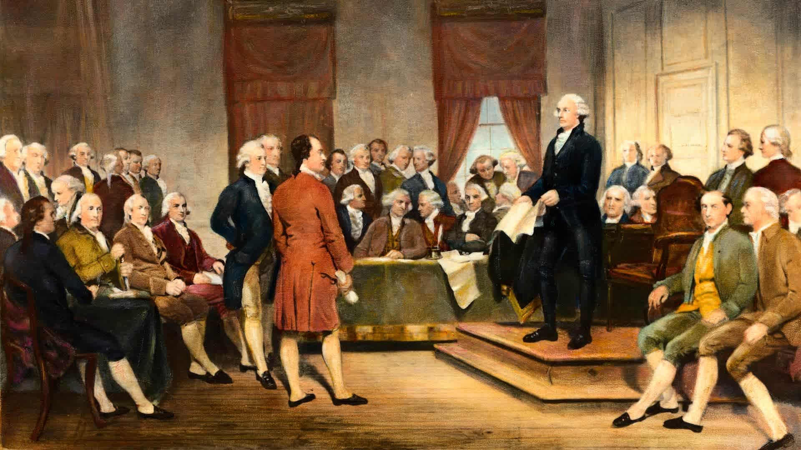
The Story of Our Constitution

Slide 3
Standards Covered in this Chapter
SSUSH5 How did specific events and key ideas bring about the adoption and implementation of the United States Constitution?
What were the strengths of the Articles of Confederation, including the passage of the Land Ordinance of 1785 and the Northwest Ordinance of 1787, and their influence on westward migration, slavery, public education, and the admission of new states?
How did the weaknesses in the Articles of Confederation, combined with Shays’ Rebellion, lead to a call for a stronger central government?
What were the key features of the U.S. Constitution, including the Great Compromise, limited government, and the Three-Fifths Compromise?
What were the major main arguments of the Anti-Federalists and Federalists during the debate over ratification of the Constitution, including those arguments expressed in The Federalist Papers by Alexander Hamilton and James Madison?
How were objections to the ratification of the Constitution addressed in the Bill of Rights?

Slide 4
Names and Terms You Should Know
Government
State constitutions
Articles of Confederation
Confederation Congress
Land Ordinance of 1785
Northwest Ordinance of 1787
Daniel Shays
Shays’ Rebellion
Constitutional Convention
James Madison
Great Compromise
Three-Fifths Compromise
Limited government
Preamble
“We the People”
Congress
Senate
House of Representatives
President
Electoral College
Supreme Court
Separation of powers
Legislature
Executive
Judiciary
Checks and balances
Federalism
Ratification
Federalists
Anti-Federalists
Alexander Hamilton
The Federalist Papers
Bill of Rights
First Amendment
Freedom of religion

Slide 5
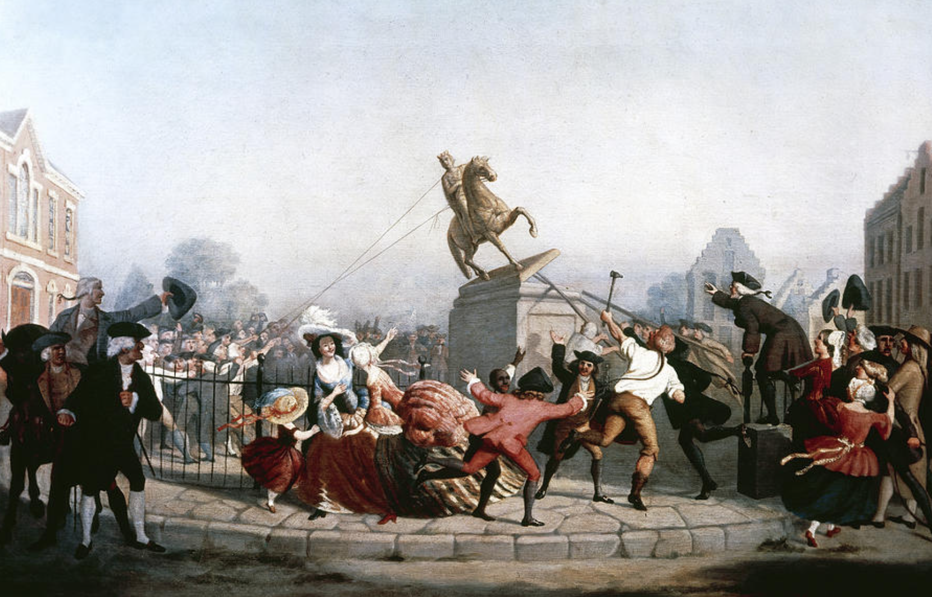
A Bold New Experiment: The “Critical Period”
The first years after the American Revolution—from 1781 to 1787—are known to historians as the “critical period.”
No colony had ever declared independence.
No large country had ever chosen to be governed by a representative democracy.
American independence was a great experiment and it was not at all certain that the country would
survive.

Slide 6
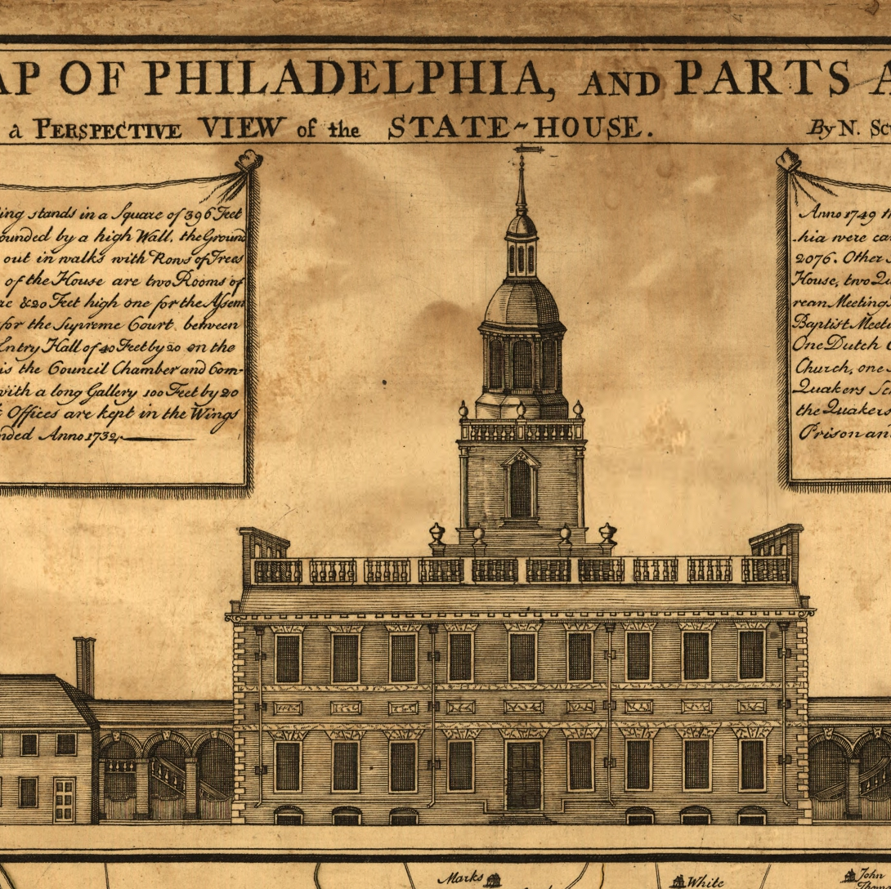
The State Constitutions
Each colony became an independent state.
Each state wrote its own constitution.
Each state constitution established a republican form of government. Most state constitutions had a bill of rights.

Slide 7
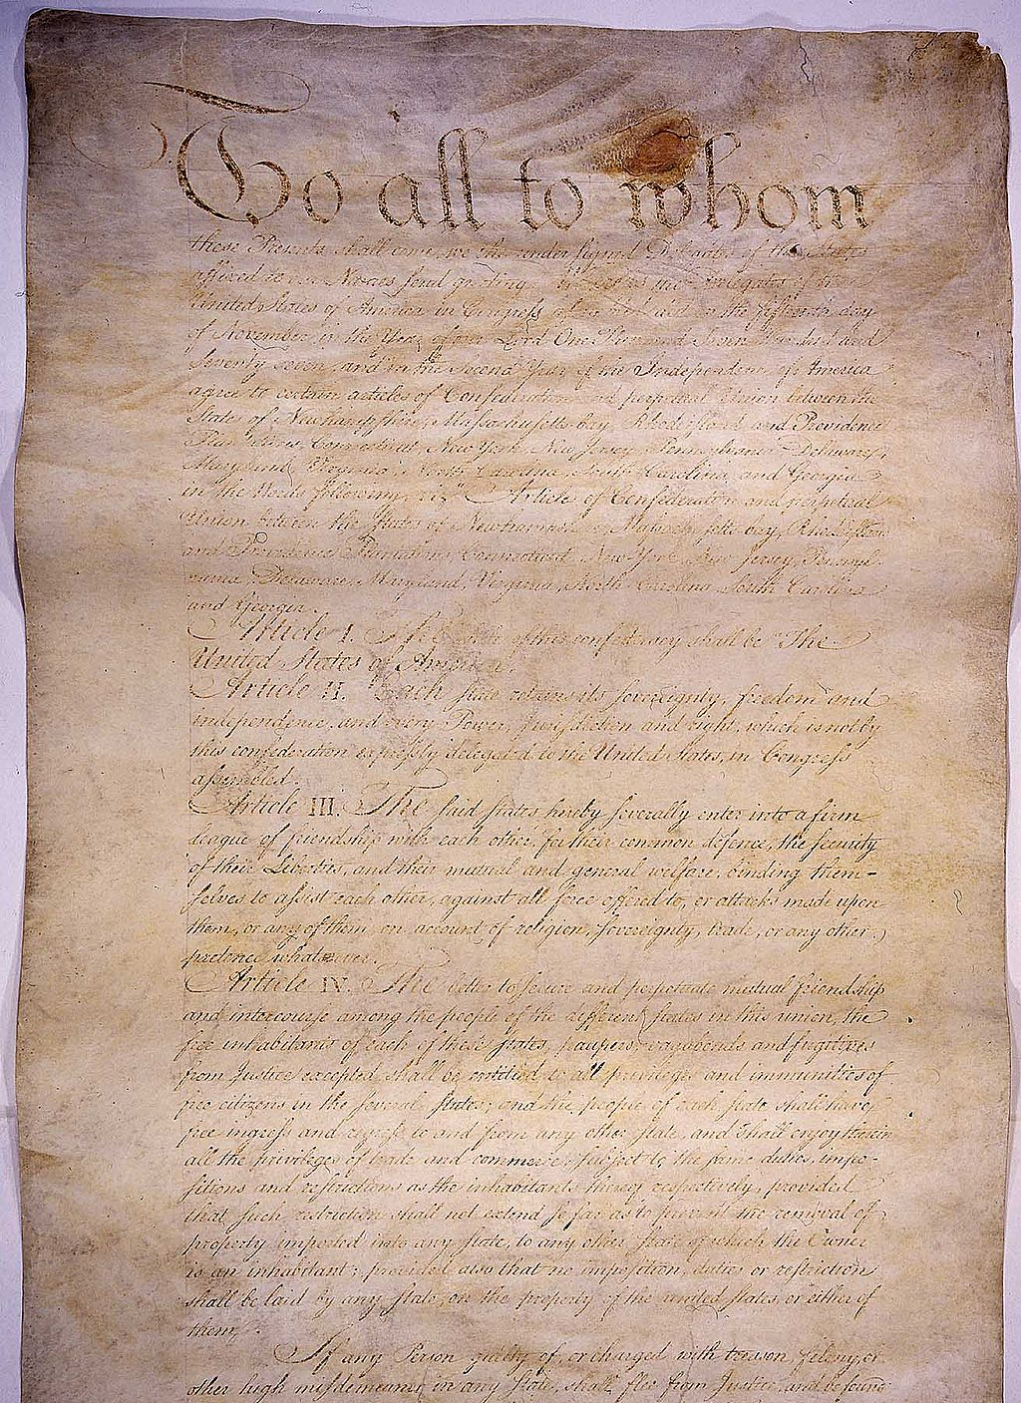
The Articles of Confederation
After declaring independence, the colonies no longer could rely on the British government to hold them together. They had to establish some form of national government for themselves.
Members of the Second Continental Convention wrote the Articles of Confederation—the blueprint for the American government from 1781 to 1787.

Slide 8
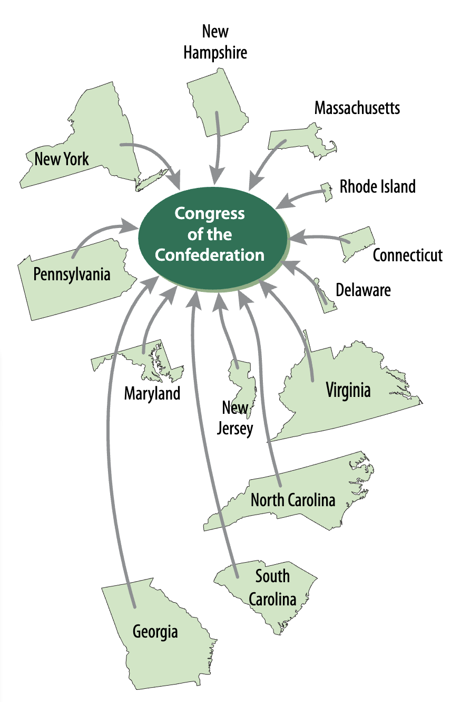
The Articles of Confederation
Americans were afraid of creating a central government that was too strong or tyrannical.
That was how they felt the British government had been.
The Articles of Confederation therefore created a very weak national government with just one branch: the “Congress” of the Confederation.
There was no national executive or national court system.
Each state had one vote in the Confederation Congress

Slide 9
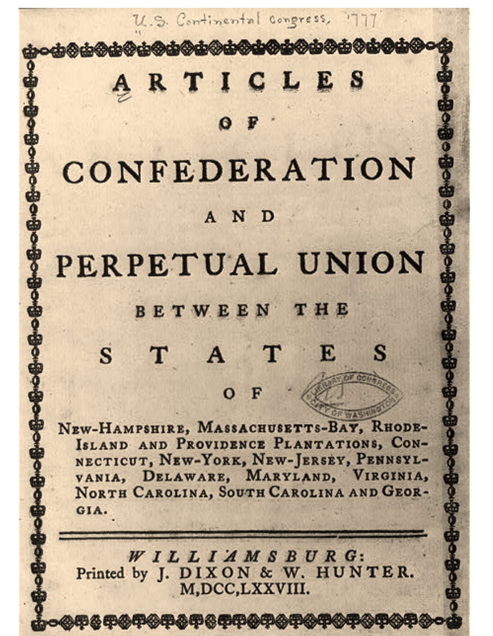
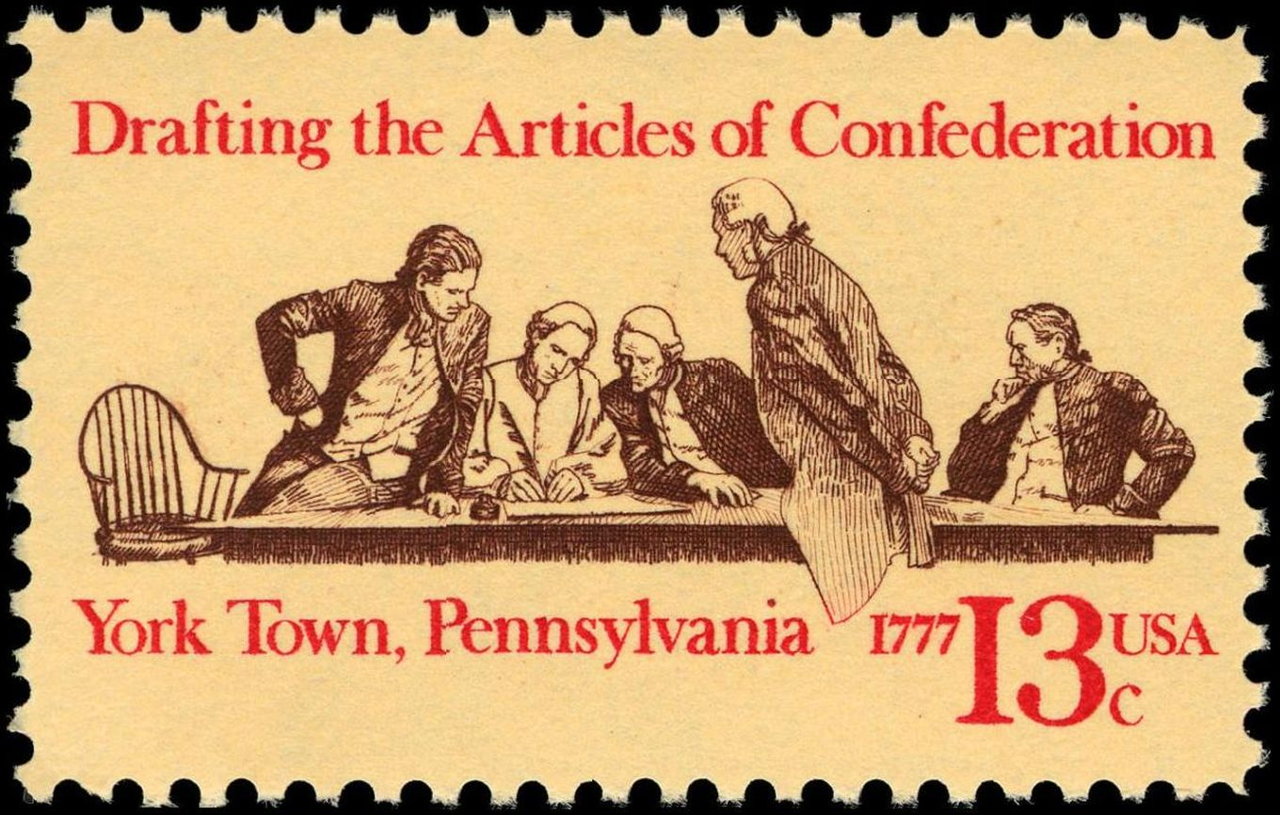
The Articles of Confederation
The Confederation Congress was to meet every year. It had very limited powers.
These included the ability to declare war, enter into treaties and alliances, resolve disputes between states, establish post offices, handle relations with Indian tribes, borrow money, build and equip a navy, and direct its own army.

Slide 10
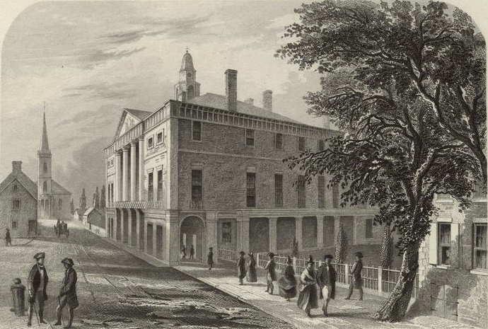
The Articles of Confederation
Congress could not raise its own troops. It also could not tax. Instead, it had to rely on contributions from the states to raise money or to have troops in an emergency.

Slide 11
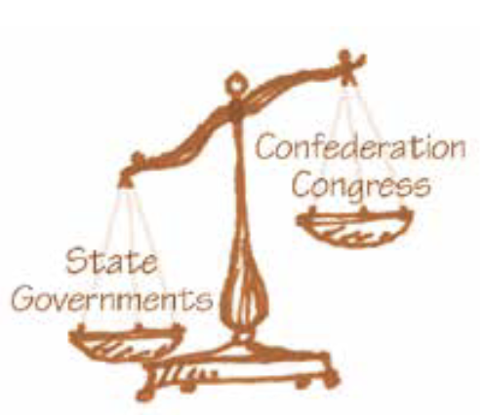
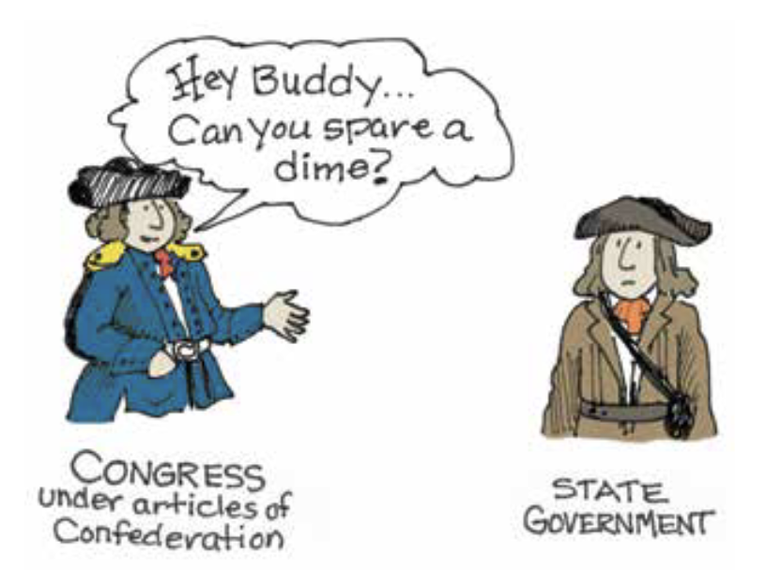
The Articles of Confederation
Individual state governments remained more powerful than the central government: states could print their own money, tax goods brought in from other states, collect taxes, and raise troops.
Each state had its own executive and courts, while the Confederation lacked either of these.
The balance of power under the Articles of Confederation

Slide 12
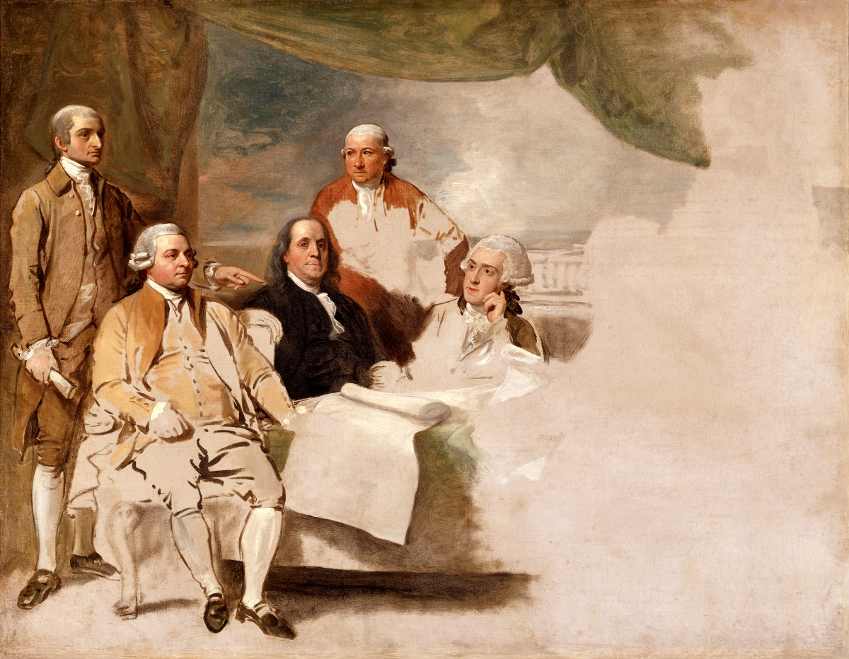
Achievements under the Articles of Confederation
Even though the new national government was weak, the Confederation Congress had two major achievements: it negotiated a peace treaty with Britain, and it established a process for admitting states to the United States.

Slide 13
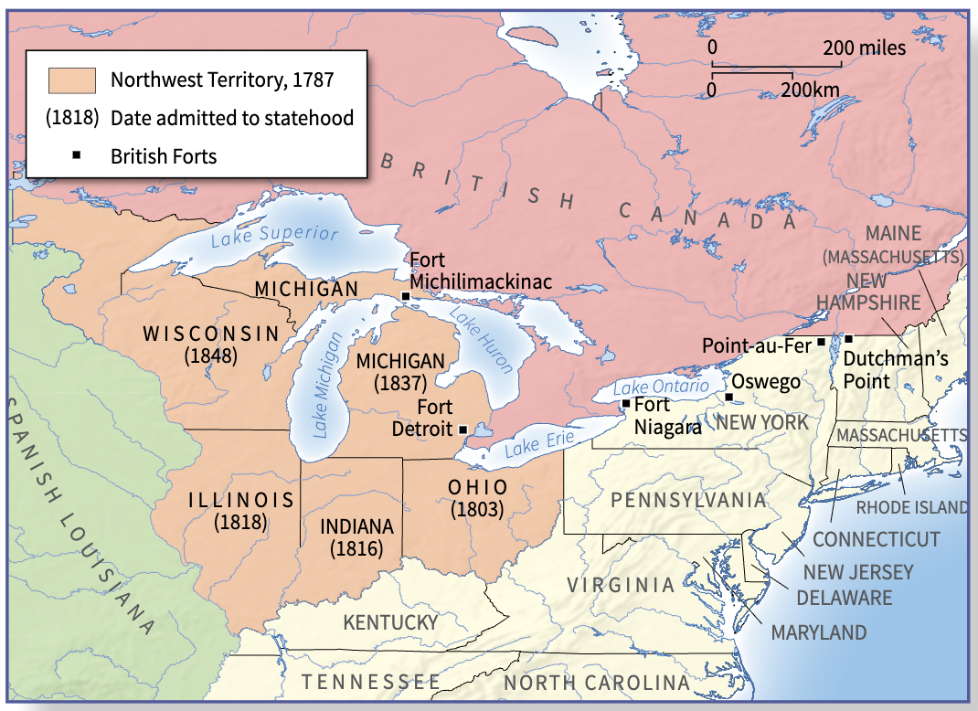
The Land Ordinance and the Northwest Ordinance
The Confederation Congress passed two ordinances (laws) to deal with the frontier lands gained in the Peace of Paris.
These new lands made up the Northwest Territory—the land between the Ohio River and the Great Lakes.
The Northwest Territory

Slide 14
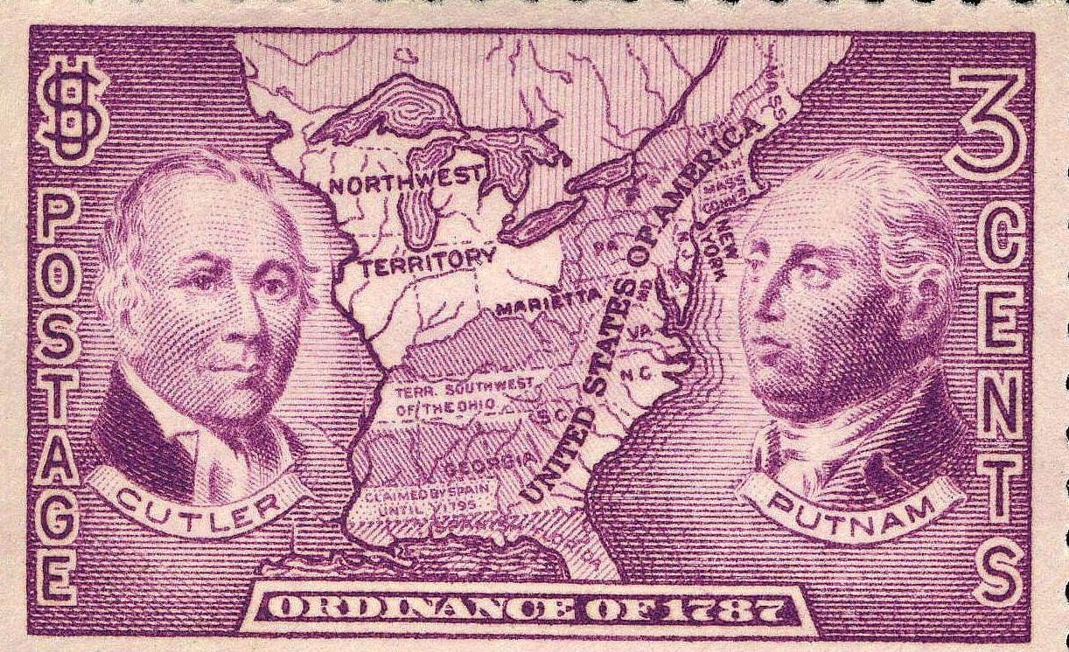

The Land Ordinance
In 1785, the Land Ordinance divided the Northwest Territory into “townships.”
Each township was a square six miles on a side. Each township was further divided into 36 smaller sections.
One section in each township was reserved for supporting a public school.
Dimensions of a Township

Slide 15
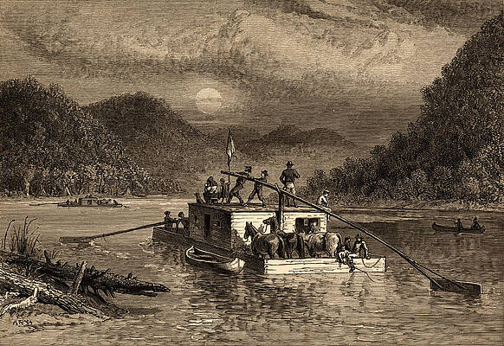
The Northwest Ordinance
In 1787, the Northwest Ordinance stated that the Northwest Territory would eventually be divided into three to five separate territories, each of which would become new states.
For example, the Ohio Territory was created in 1800 and the Territory of Illinois was created in 1809.
Settlers moving into the Northwest Territory

Slide 16
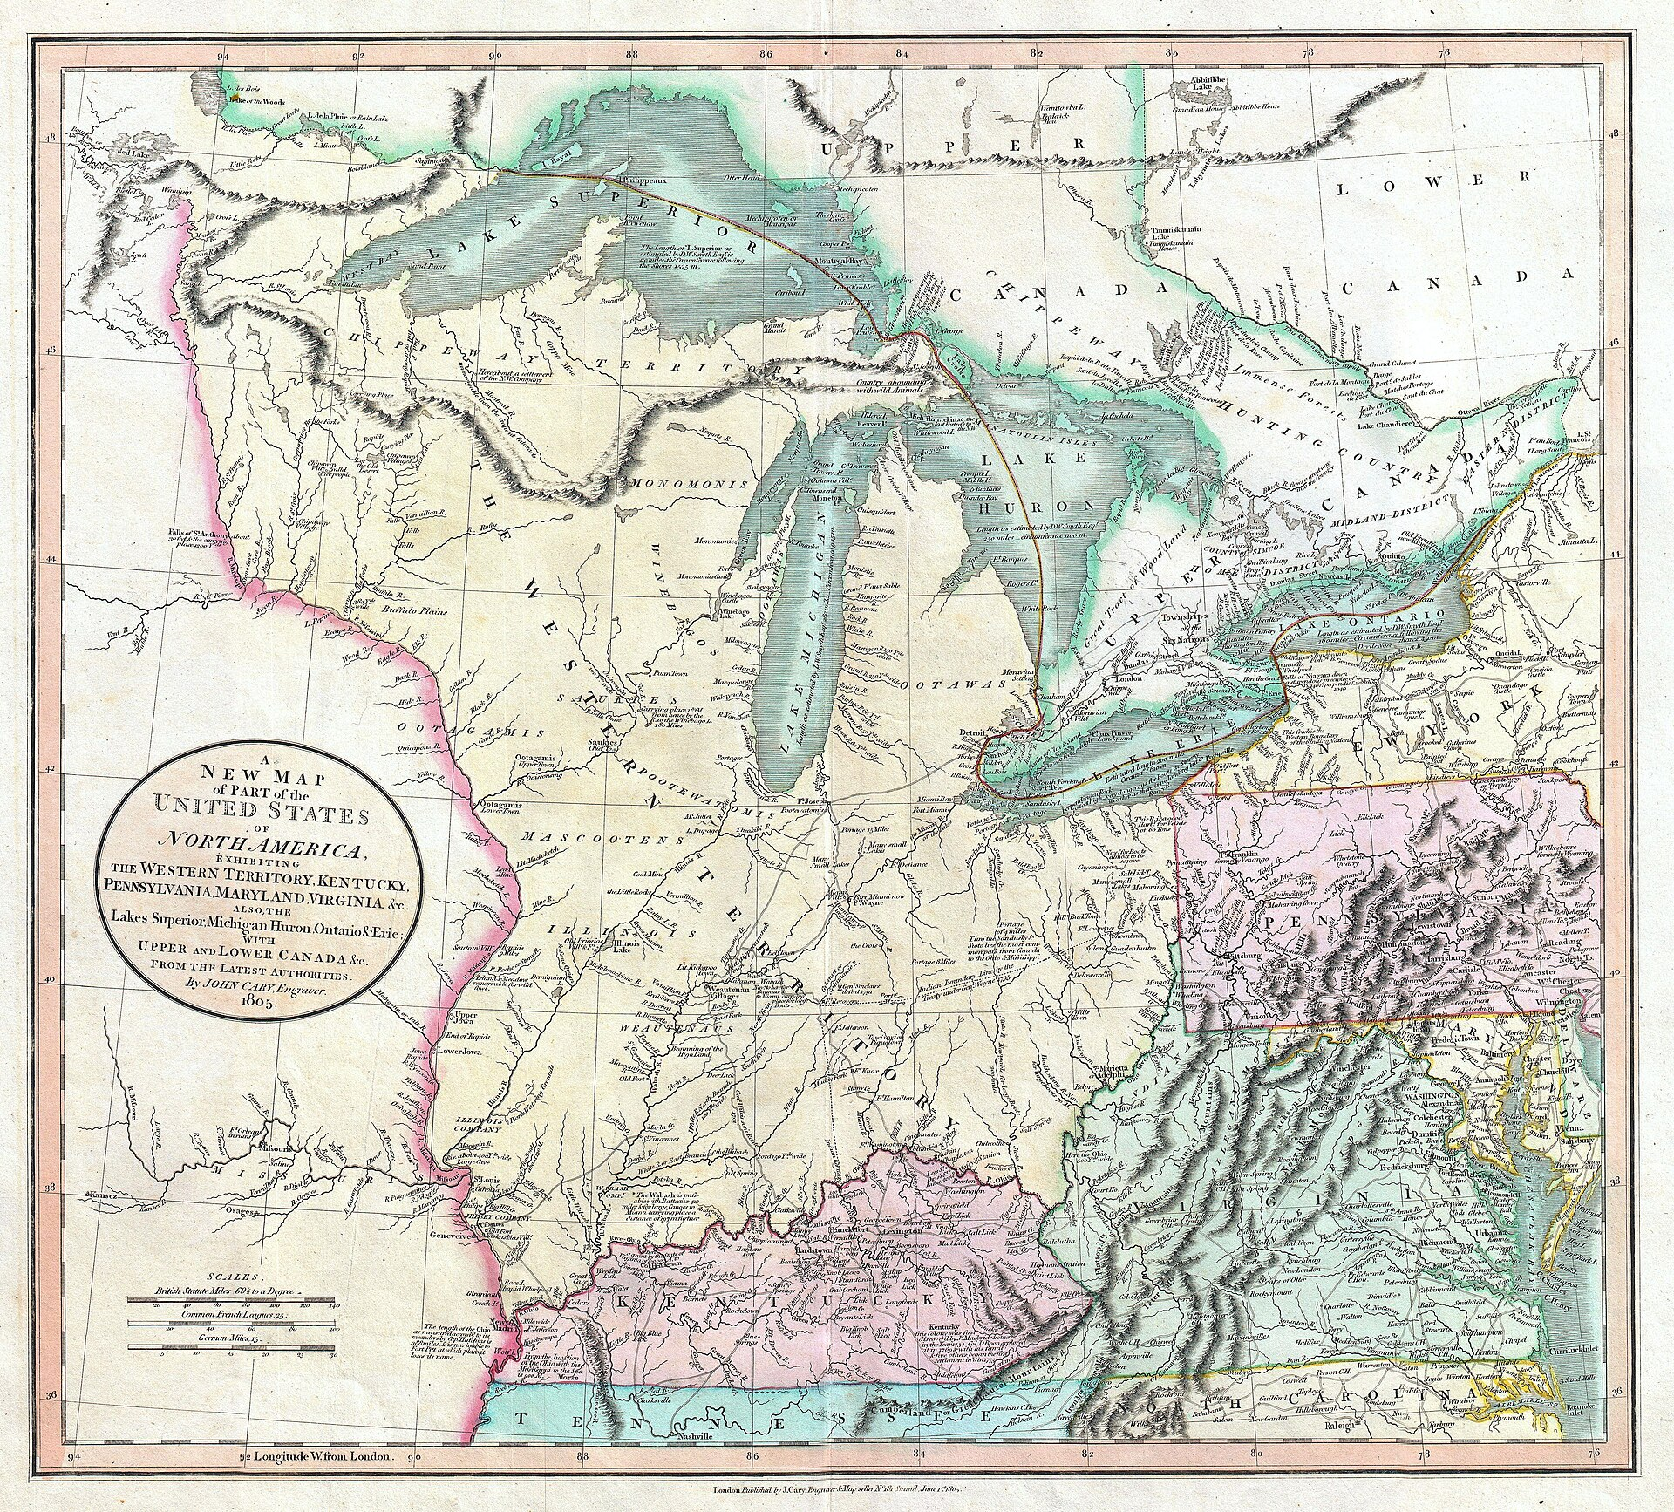
The Northwest Ordinance
The Northwest Ordinance set up a procedure for admitting each territory, once it reached a certain size in population (60,000 free inhabitants), to the United States as a new state “on an equal footing with the original states.”
The Northwest Ordinance prohibited slavery throughout the Northwest Territory. Most states in the Northeast were ending slavery gradually by freeing slaves’ children.
The Northwest Ordinance also guaranteed freedom of religion and the right to a trial by jury. All adult males in the Northwest Territory had the right to vote.

Slide 17
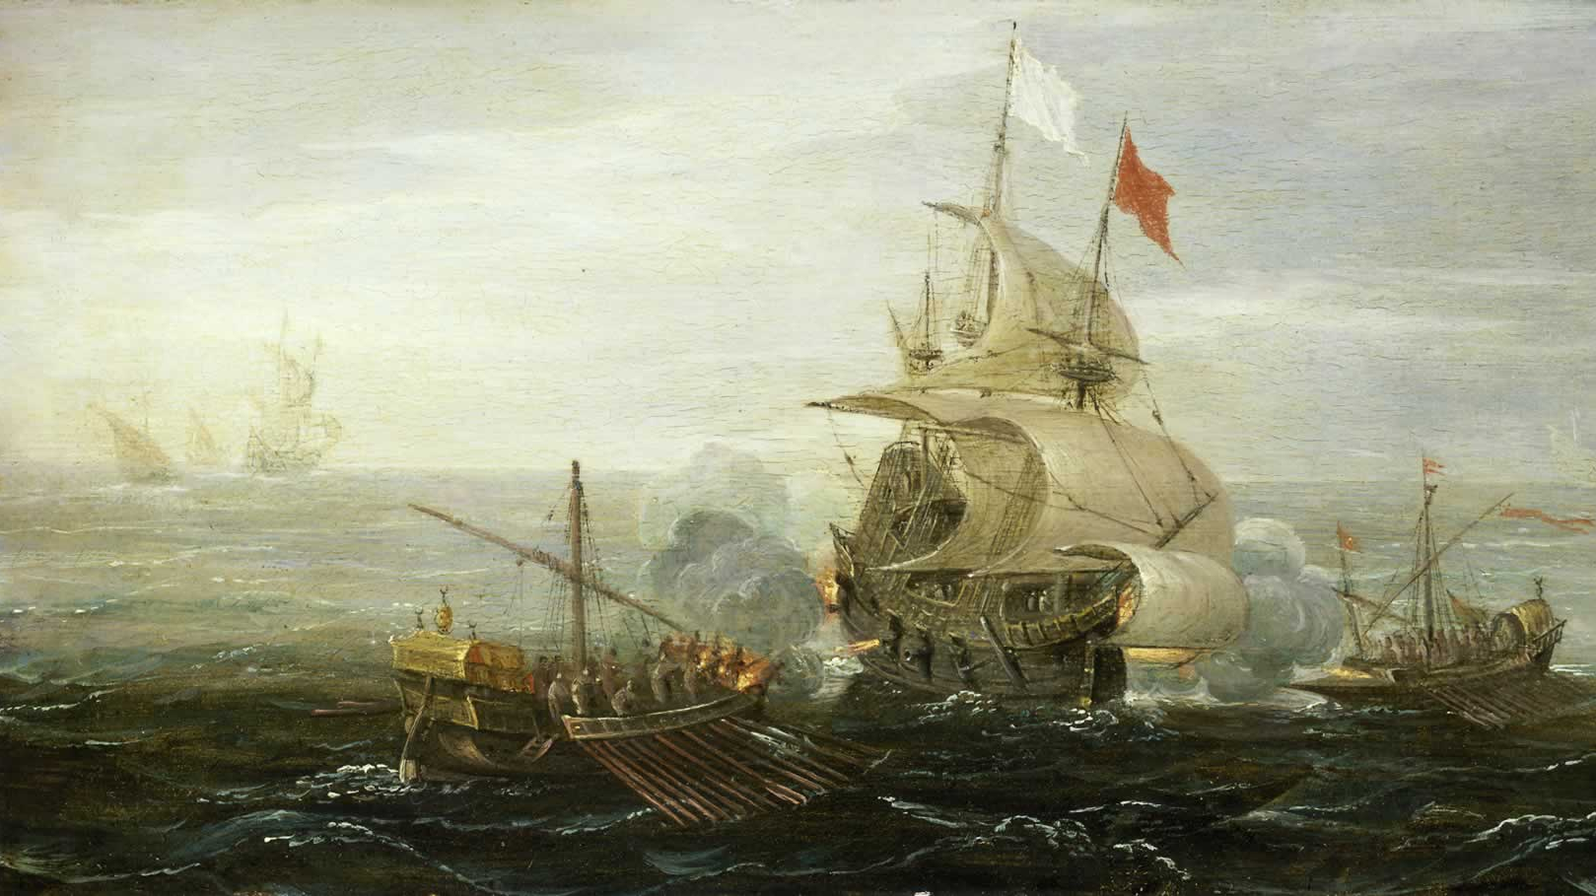
Problems Under the Confederation
The new government had problems with foreign nations.
The British held onto several forts in the Northwest.
Spain challenged the southwest border of the United States.
Pirates in North Africa attacked American ships.

Slide 18
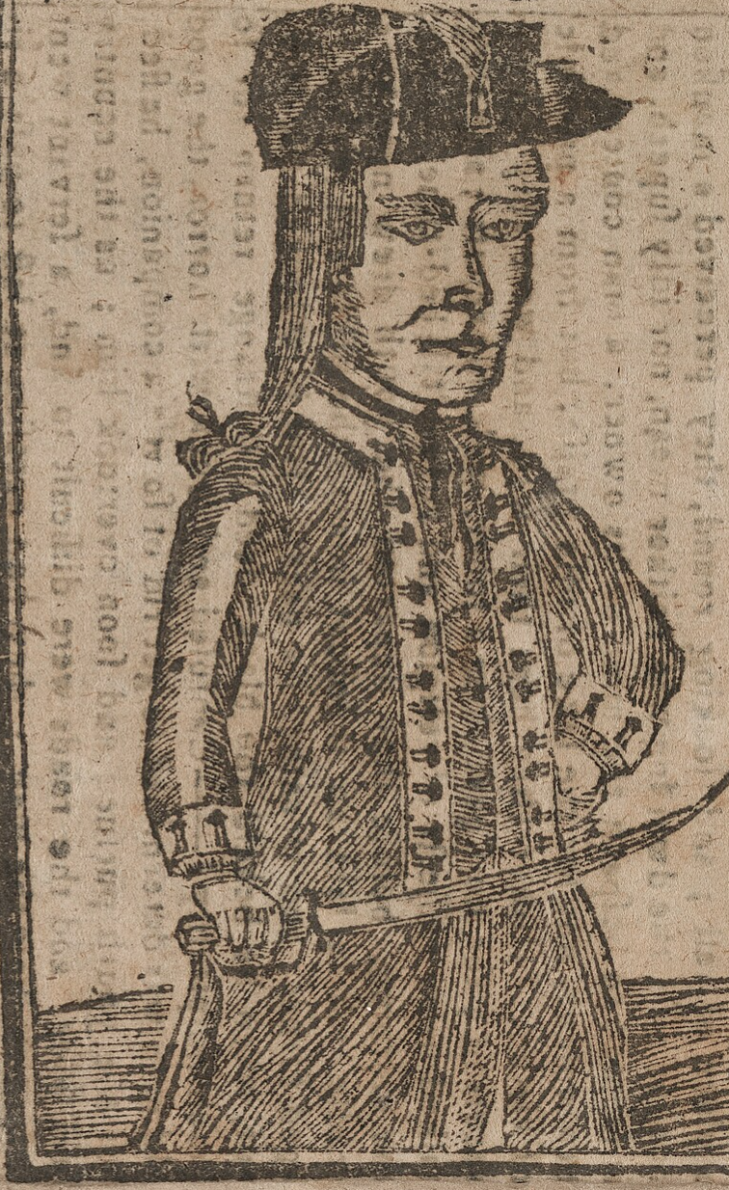
Problems Under the Confederation
Shays’ Rebellion
There were economic problems as well. States taxed each other’s goods, hurting trade between them.
The British refused to sign a trade agreement with the Confederation government. They claimed that trade was actually handled by individual states and not by the national government.
There was a general shortage of money. Some state governments even refused to pay their debts from the Revolution and overseas creditors.
Daniel Shays, a Massachusetts farmer, had served as a captain during the American Revolution. Shays led a group of angry farmers and debtors in an attack on one of the state’s courthouses. They demanded freedom for debtors, cheap paper money, and lower taxes.

Slide 19
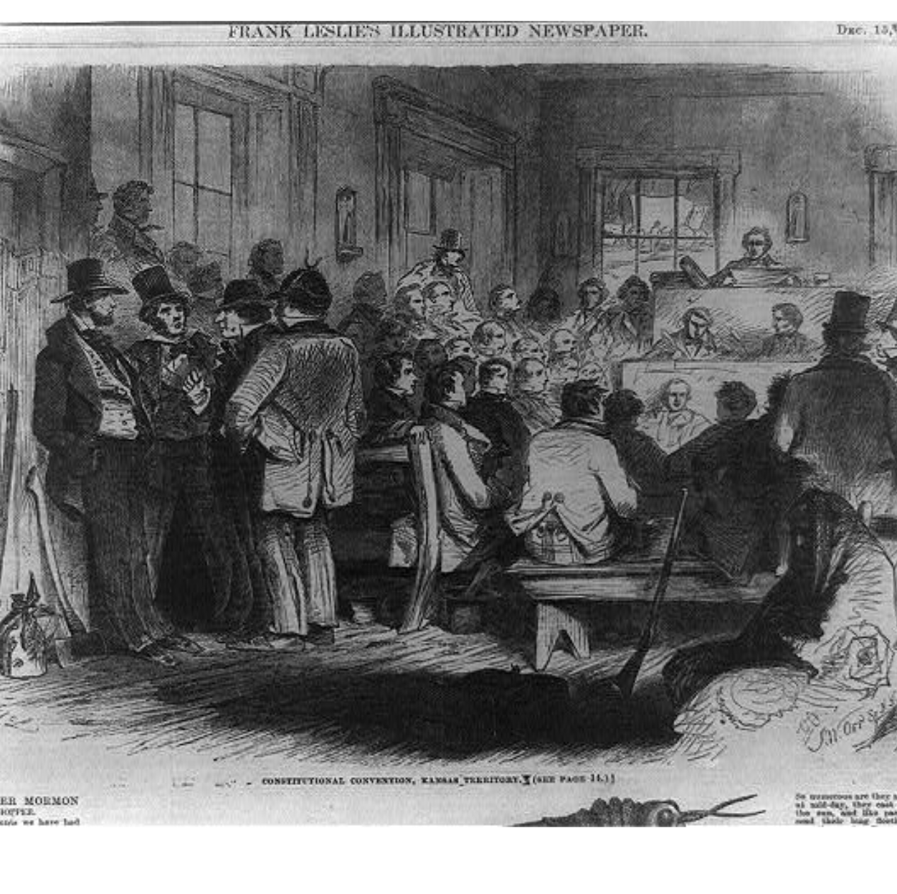
The Constitutional Convention
In May 1787, fifty-five delegates gathered in Philadelphia to revise the Articles of Confederation. Instead, they decided to write a whole new constitution (plan of government). Their assembly became known as the Constitutional Convention.
The delegates agreed that the new national government should have three separate branches: a legislature, executive, and judiciary.

Slide 20
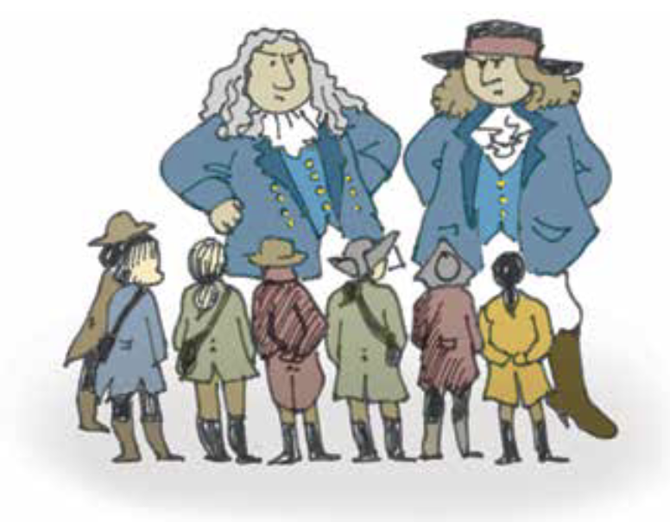
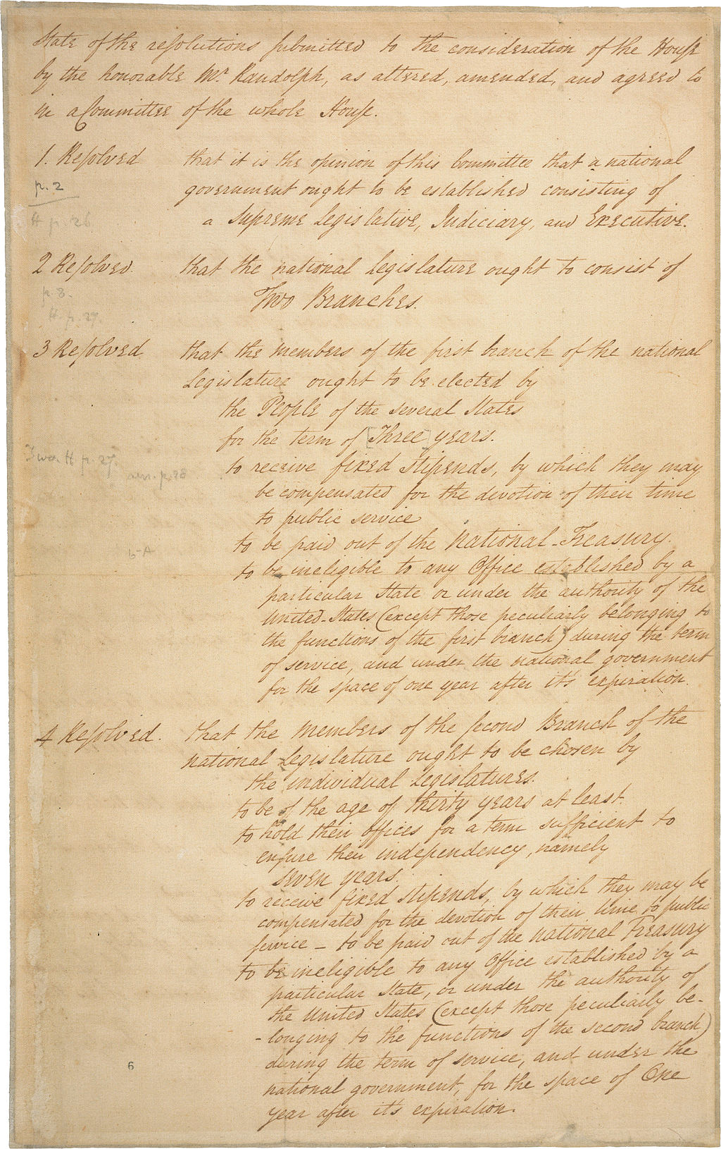
The “Great Compromise”: Large versus Small States
The delegates did not agree on everything. The biggest disagreement was between large and small states. Larger states wanted more representatives in Congress.
The Virginia Plan proposed that each state should be represented in proportion to its population in both houses of Congress. This is known as proportional representation.
The New Jersey Plan proposed a one-house legislature with equal representation for each state.

Slide 21
The “Great Compromise”: Large versus Small States
Connecticut delegates proposed a compromise in which states would enjoy proportional representation in the House of Representatives and equal representation in the Senate.
In the end, delegates agreed that each state should have two Senators in the Senate and proportional representation in the House of Representatives. This solution became known as the “Great Compromise.”

Slide 22
The Electoral College
The delegates feared having the people elect the President directly. Instead, they decided that the President should be chosen by the Electoral College.
The number of each state’s electors would equal the sum of its representatives in both houses (Members in the House + 2 for its two Senators).
If no candidate won a majority of the Electoral College, the House of Representatives would select the President.

Slide 23



“Three-Fifths Compromise”: South vs North
Another disagreement was over how states with large enslaved populations would be represented. Southerners wanted enslaved people to count as part of the population of each state in determining the number of representatives in Congress. Northern states had fewer slaves or none at all. Northerners believed slaves should not be counted because they did not vote.
Northern delegates thought slaves should be counted, however, for purposes of taxation.
The delegates reached the “Three-fifths Compromise.” They agreed that slaves would count as three-fifths of their actual number for purposes of both representation and taxation. For example, if a state had 100,000 free residents and 100,000 enslaved residents, its population would be considered as 160,000.
=
=

Slide 24
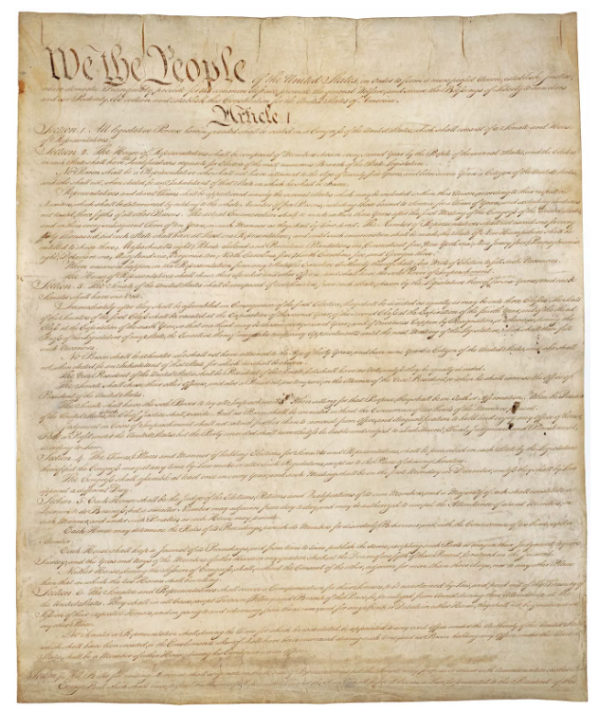
Constitutional Principles
Several constitutional principles prevented the federal government from becoming too strong:
Federalism: The division of power between the federal government and the state governments. The federal government deals with issues affecting the nation; state governments deal with matters affecting the individual states.
Limited Government: Our government does not have unlimited powers. It only has those powers that citizens agree it should have. The new federal government could only exercise those powers given to it by the Constitution.
Original copy of the U.S. Constitution, housed in the National Archives in Washington, D.C.

Slide 25
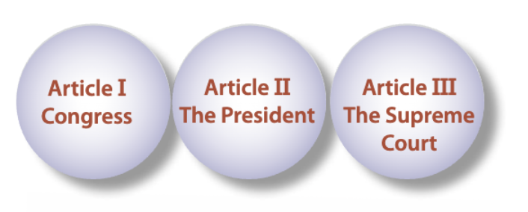
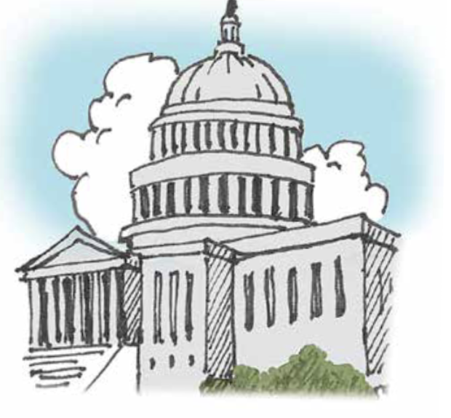
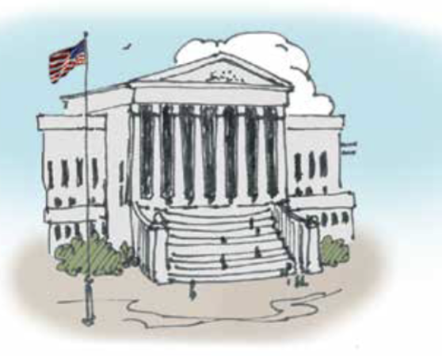
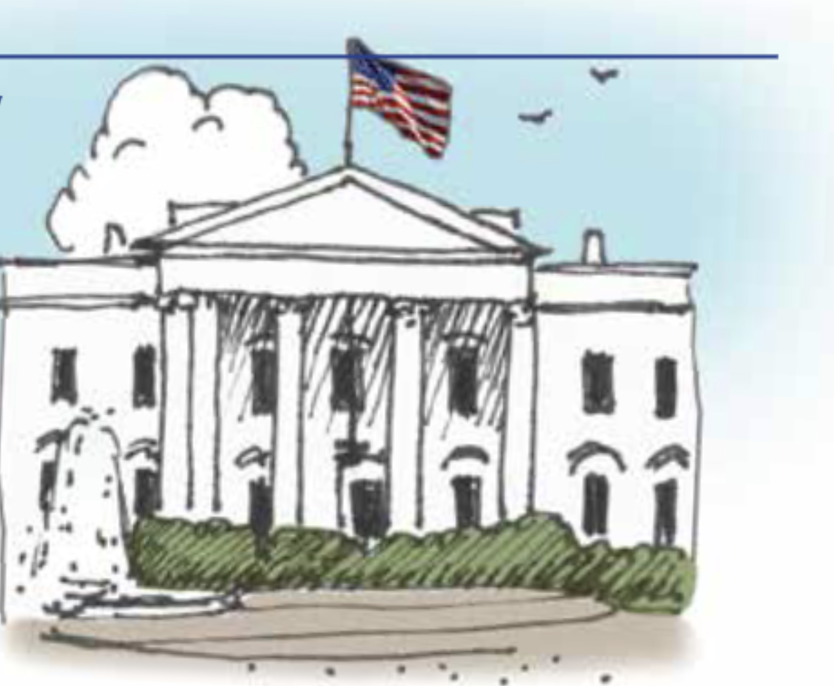
Constitutional Principles
Separation of powers: The separation of power between the legislative, executive, and judicial branches. Each branch exercised independent powers.

Slide 26
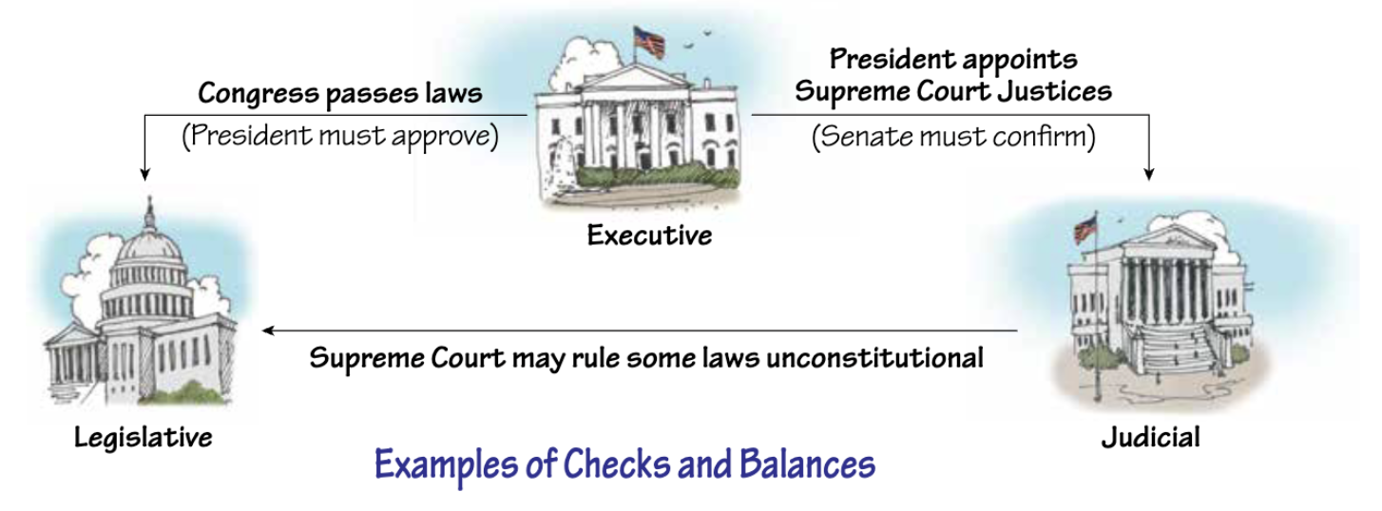
Constitutional Principles
Checks and balances: Each branch has specific powers allowing it to “check”—or stop—the other two branches. This prevents any one branch from becoming too powerful. It also encourages cooperation between the branches.

Slide 27
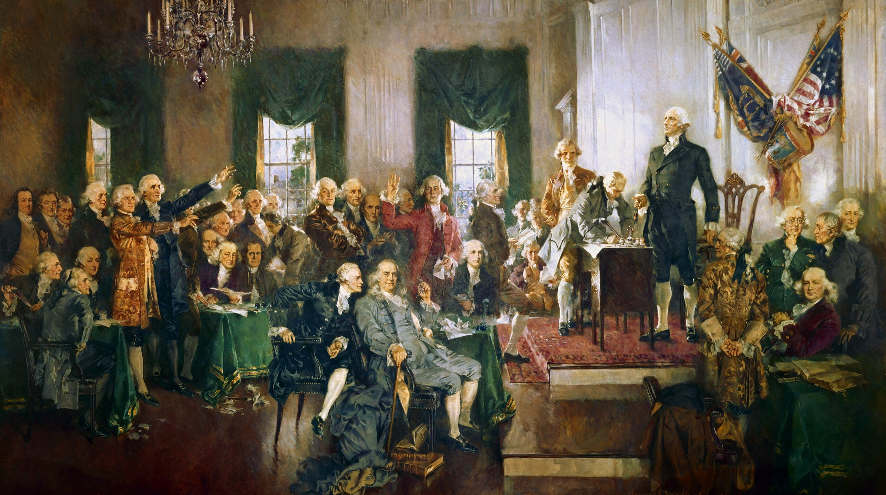
Scene at the Signing of the Constitution of the United States on September 17, 1787, a 1940 painting by Howard Chandler Christy

Slide 28
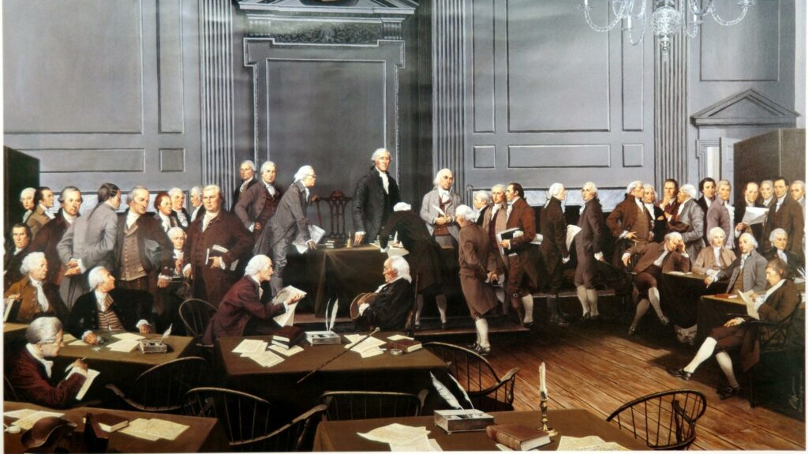
The Signing of the United States Constitution by Louis S. Glanzman, 1987

Slide 29
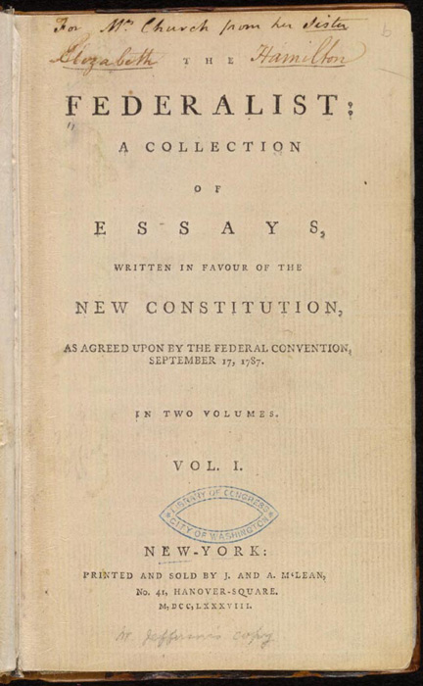
The Ratification Debate: Federalists versus Anti-Federalists
Federalists favored the new Constitution. They argued that a stronger government was needed to protect Americans and to hold the nation together. The constitutional principles of federalism, the separation of powers, and checks and balances would protect individual liberties and prevent the new federal government from becoming too strong.
Federalist arguments were best expressed by James Madison, Alexander Hamilton, and John Jay in a series of essays known as The Federalist Papers. The essays were written to persuade New Yorkers to ratify the Constitution.

Slide 30
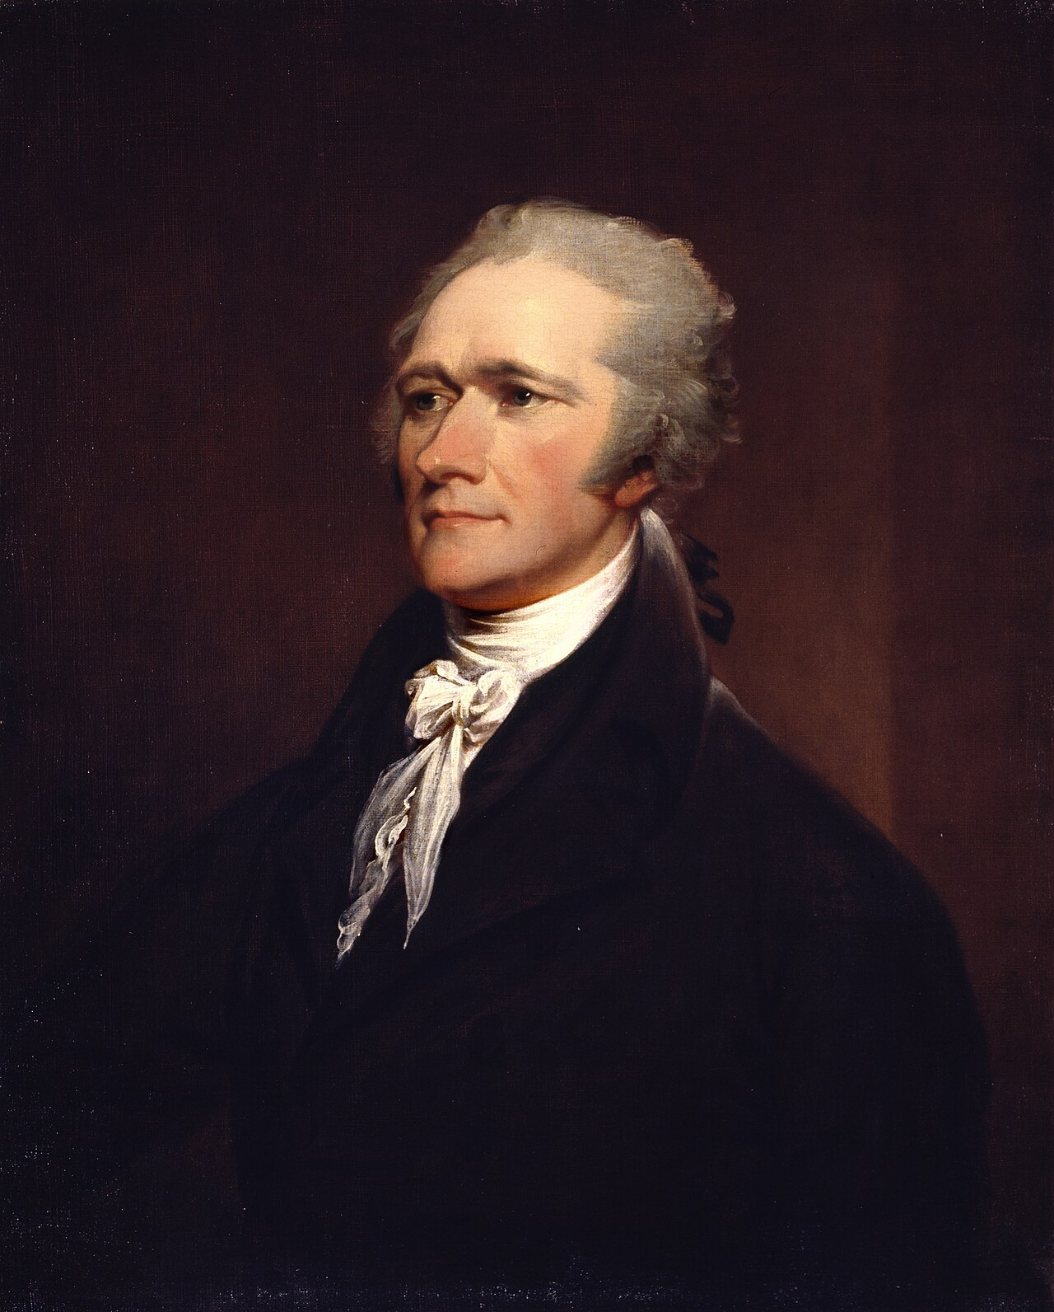
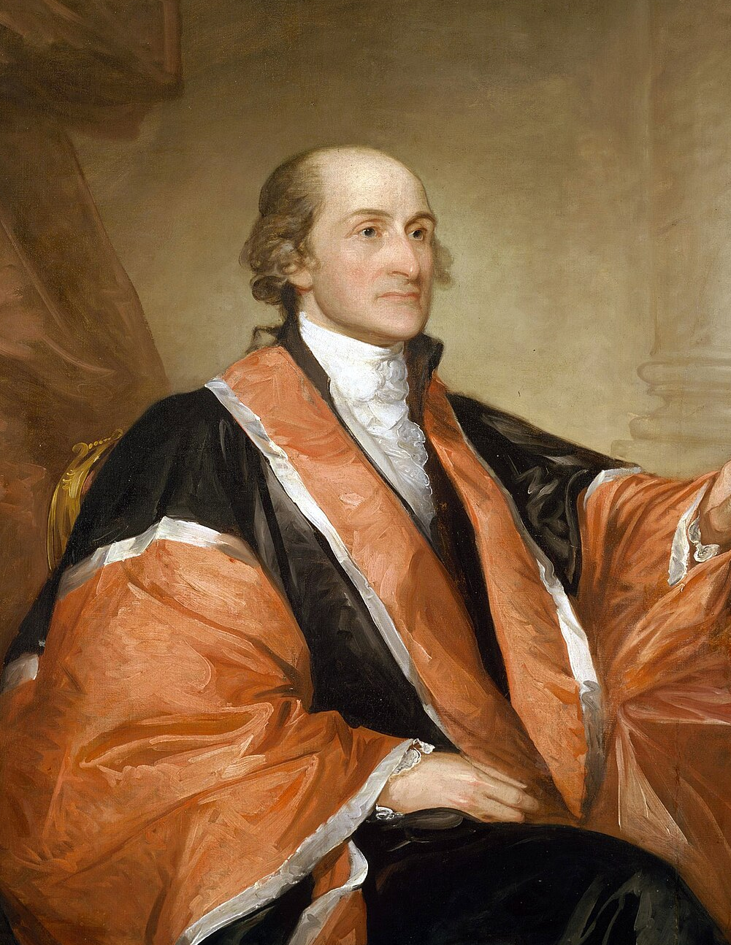
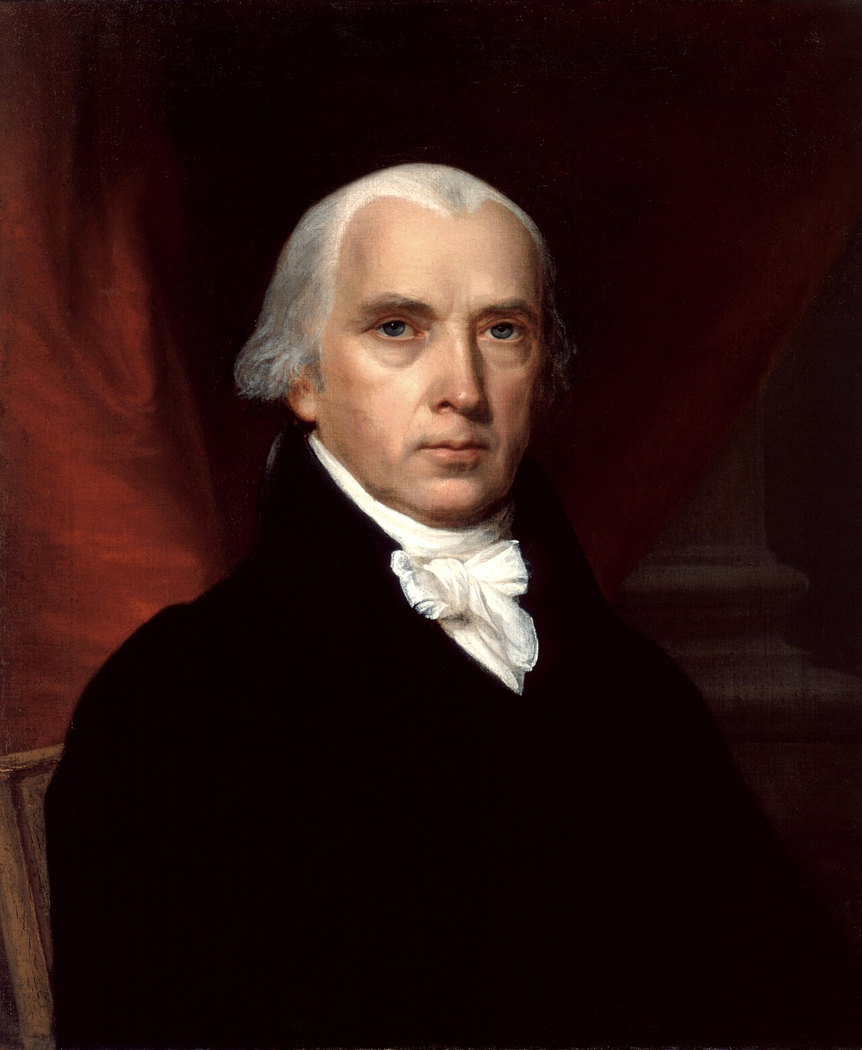
The Ratification Debate: Federalists versus Anti-Federalists
Alexander Hamilton
John Jay
James Madison

Slide 31
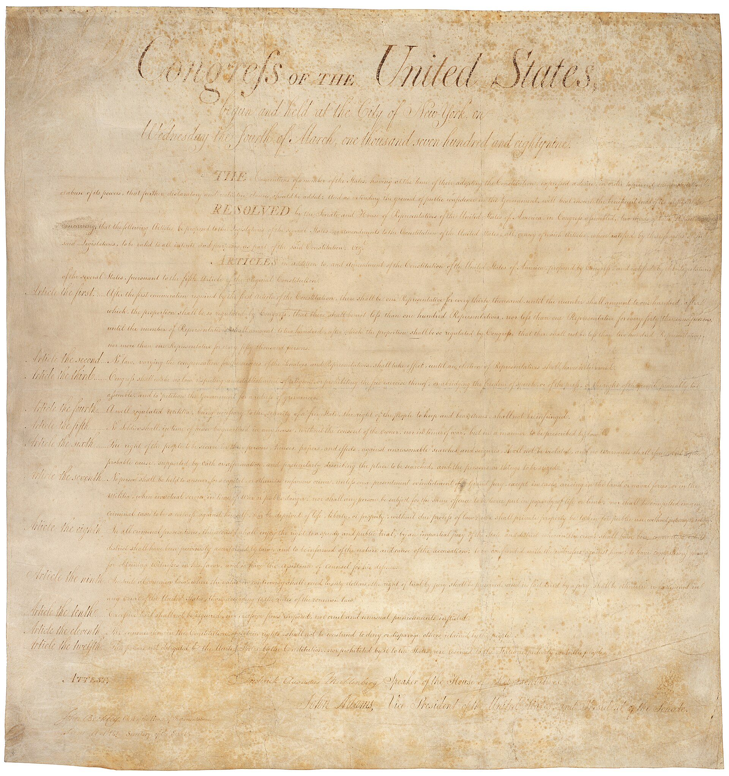
The Ratification Debate: Federalists versus Anti-Federalists
Anti-Federalists opposed the new Constitution. They feared the new central government was just as oppressive as the British government had been.
Anti-Federalists complained that there was no bill of rights (a list of rights guaranteed to individuals) in the Constitution.
To win popular support for the new Constitution, the Federalists promised a bill of rights.
The first Congress proposed several amendments in 1789, ten of which were ratified by the states in 1791. These amendments are known as the “Bill of Rights.”

Slide 32
The Bill of Rights
The Bill of Rights consists of the first ten amendments to the U.S. Constitution. They were proposed by the first Congress and ratified by the states in 1791. The Bill of Rights addressed many of the concerns expressed by the Anti-Federalists in the debates over ratification. These ten amendments protect citizens from unfair actions by the federal government:
First Amendment: The First Amendment actually grants five freedoms. Congress cannot establish a state religion. Individuals have the right to freedom of religion. Congress cannot abridge freedom of speech or freedom of the press, though there are limits when public safety and civil disorder are involved. Congress cannot prevent people from peaceable assembly, unless the crowds become dangerous. Congress cannot deny people the right to petition their government to seek redress for their grievances.
James Madison

Slide 33
The Bill of Rights
Second Amendment: People have the right to own and carry firearms.
Third Amendment: Soldiers cannot be quartered in people’s homes without their consent.
Fourth Amendment: People have a right to privacy. Their homes, workplaces, possessions and person cannot be searched by police unless officers can prove probable cause (reasonable grounds) and obtain a warrant. There are some exceptions, such as when an officer is chasing a suspect.

Slide 34
The Bill of Rights
Fifth Amendment: A person cannot be charged for murder without an indictment by a grand jury. No person can be tried twice for the same crime (double jeopardy). No one can be forced into self-incrimination (testifying against themselves), and people can refuse to answer incriminating questions by “pleading the Fifth.” No one can have life, liberty, or property taken away by the government without “due process of law” (fairness). If the government uses eminent domain to take a person’s private property for public use, the person must be fairly compensated.

Slide 35
The Bill of Rights
Sixth Amendment: Someone accused of a crime has the right to a speedy and public trial, the right to trial by an impartial jury made up of peers (equals), the right to be informed of the nature of their accusations, the right to confront witnesses, the right to compel witnesses to appear in court, and the right to have the assistance of counsel (an attorney).

Slide 36
The Bill of Rights
Seventh Amendment: People also have the right to a trial by jury in many civil (non-criminal) cases.
Eighth Amendment: A person can post bail to leave jail while awaiting trial. The government cannot demand an excessive amount for bail. Any fines on the defendant should not be excessive. No individual should suffer cruel and unusual punishment for committing a crime.
Ninth Amendment: Other rights not specifically listed in these amendments that may also be protected.
Tenth Amendment: All rights and powers not given to the federal government by the Constitution are reserved for the states and the people.

